Slide 1
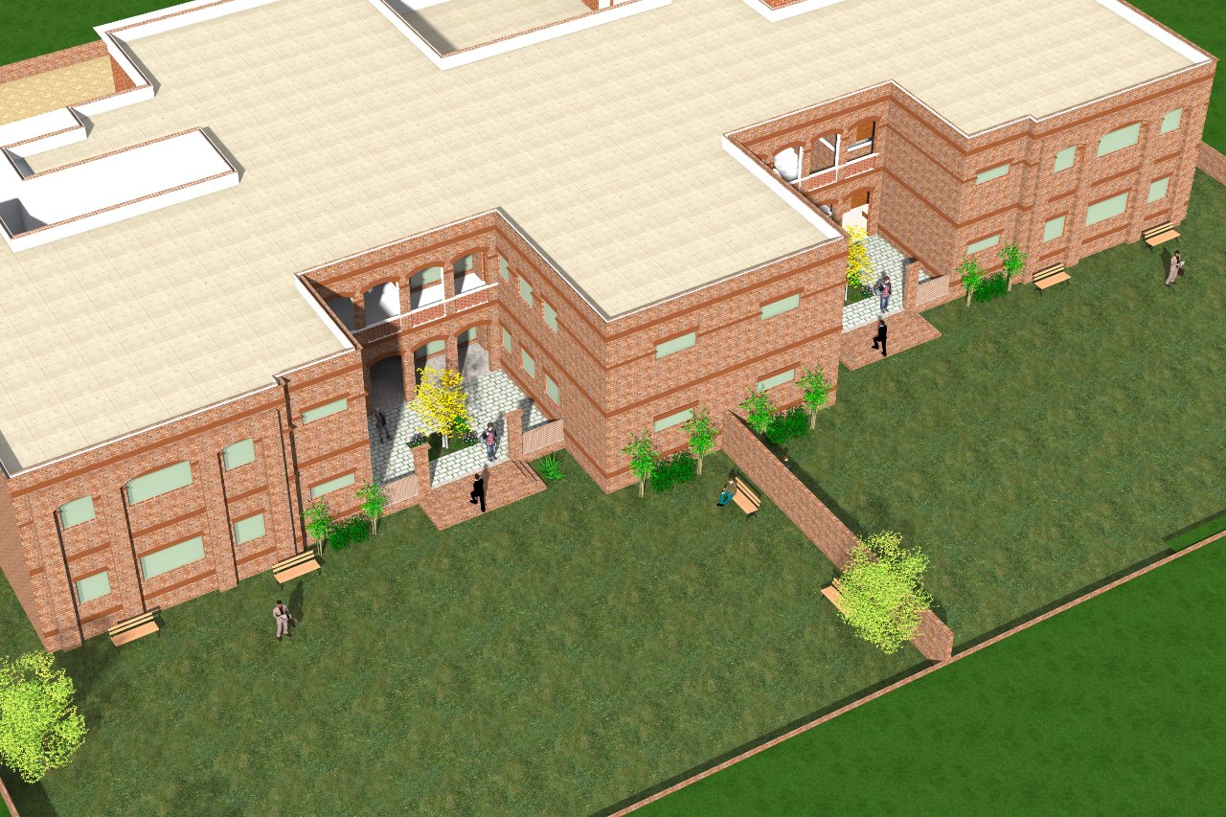

SOS Child Home, Multan
By: SOS Children’s Village of Multan, Pakistan

Slide 2
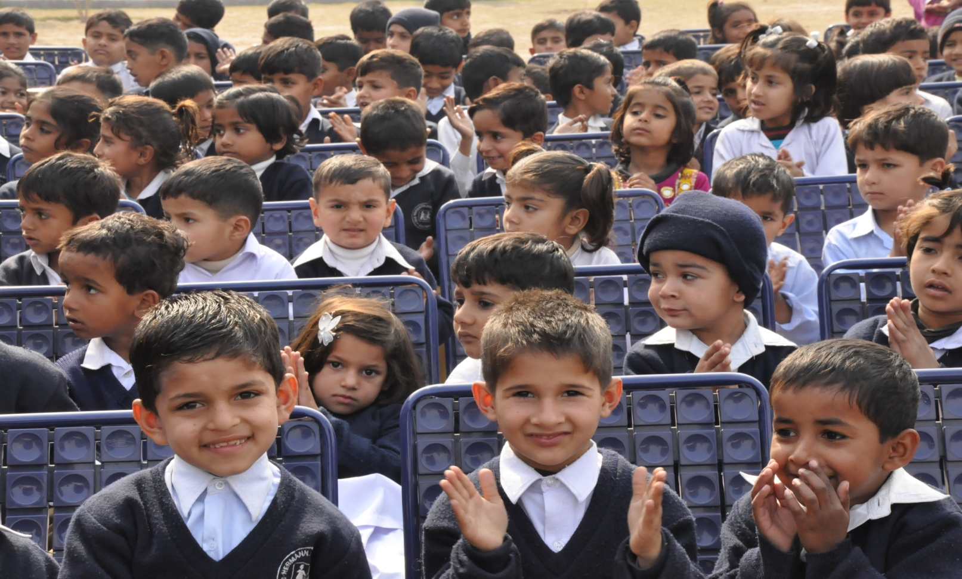
Current Projects of SOS Children’s Village Multan
SOS Children’s Village, Multan
A Home to 200 orphans, destitute and abandoned children
SOS Hermann Gmeiner Higher Secondary School, Multan
Educating 1250+ under privileged children
SOS Multan Institute of Technology
Empowering 1500 youth for employment
SOS Multan Stitching Home
Empowering 50+ women towards financial sustainability

Slide 3
SOS Child Home A new endeavor of SOS Children’s Village of Multan
2019 will mark the year of a new major endeavor of the SOS Multan family, as we intend to extend our outreach to more and more deserving children of the Southern Belt of Punjab.
SOS Child Home, Multan will provide a newfound vision of pastoral care for susceptible and vulnerable children of destitute single women.

Slide 4
Why SOS Child Home? A new endeavor of SOS Children’s Village of Multan
When a woman is left destitute, widowed, abandoned and helpless in society, her children become most susceptible to victimization
The socio-economic lower strata of women in Pakistan face many issues for financial sustenance due to being uneducated and suppressed
In the instance a woman becomes widow or single, she often finds no respite to develop a chain of sustenance for herself or her children
This creates insecurities such as homelessness, lack of education and health catastrophes and leaves the children susceptible to crime, violence and abuse
Lack of any existing policies in protecting the rights of such vulnerable children leaves them in great peril and their participation as youth in society becomes turbulent creating an unstable environment country wide.

Slide 5
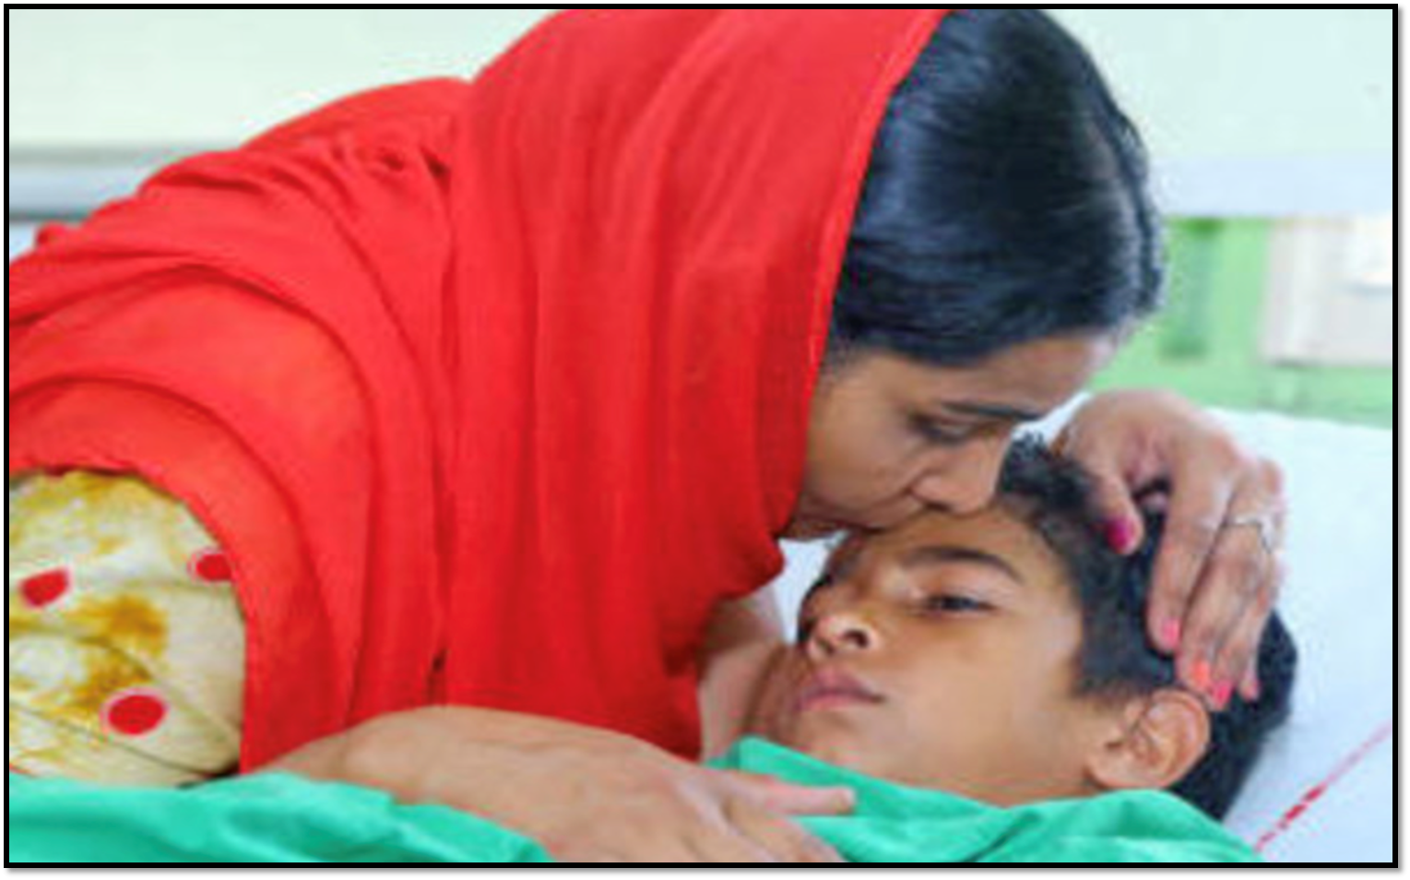
What is SOS Child Home?
SOS Child Home aims to provide pastoral care for susceptible and vulnerable children of destitute single women who will reside in a purpose-built residential campus promising them livelihood and education.

Slide 6
SOS Child Home A new endeavor of SOS Children’s Village of Multan
The SOS Child home will welcome the children whose mothers are unable to provide them with basic rights of childhood.
It will provide education, healthcare and pastoral care by taking these children under its wings from early years up till school leaving diploma.
This facility will also go hand in hand in motivating single women to find the stimulus to become financially empowered.
As a start, we aim to offer this new project to 100 vulnerable children while ensuring that their expenses are met through private and corporate financial donations.

Slide 7
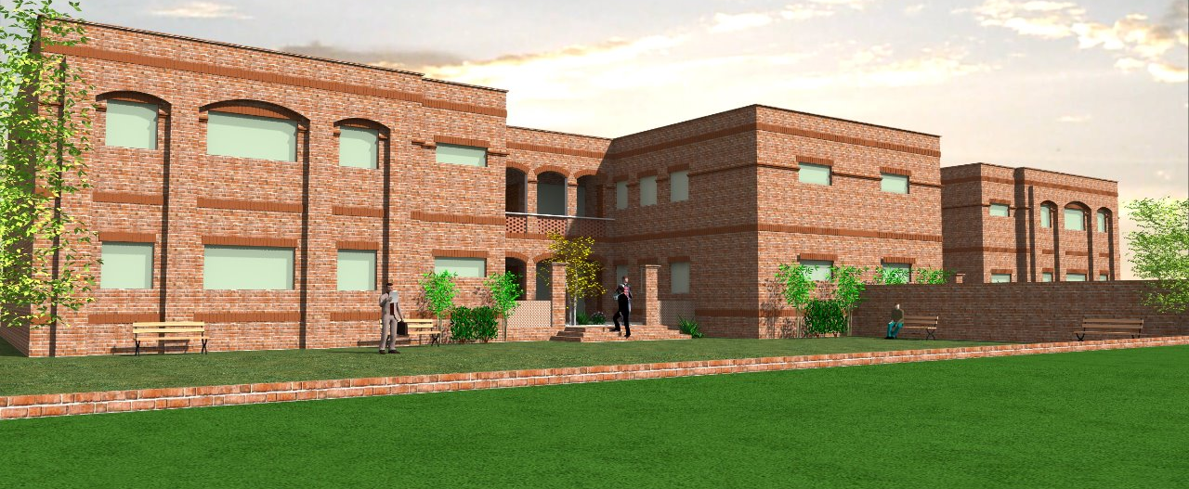
A purpose-built residential campus promising livelihood and education.

Slide 8
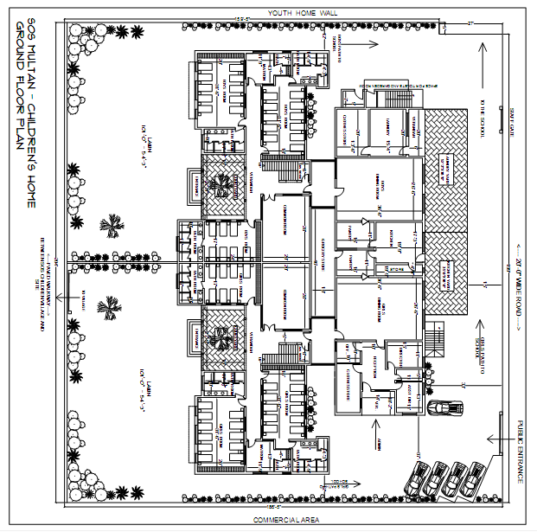

Slide 9
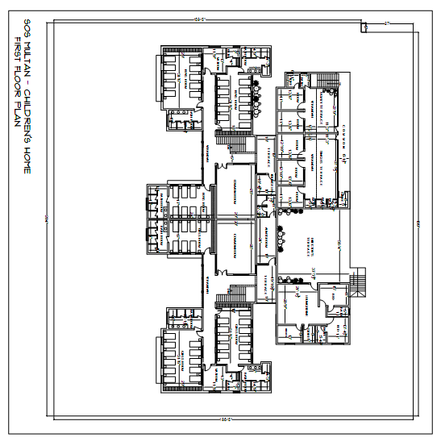

Slide 10


Slide 11
For more information
Contact SOS Children’s Village, Multan
At +92 61 6514144

